Slide 1


Innov8 challenge
Resume Keyword Highlighter
Hackathon
Hosted by Aries and Eightfold AI
Made By
-Pranjay Sidhwani
-Shriom Kumar Singh

Slide 2
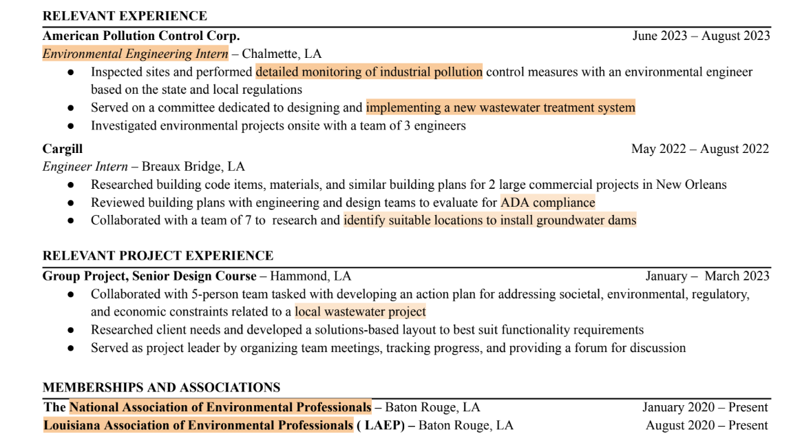
Problem Statement
We intend to build a resume highlighter tool, this will help highlight specific points in a given resume for a desired role.
This tool will be extremely effective in pin-pointing the strong points of the candidate and will help to make the resume stand out

Slide 3
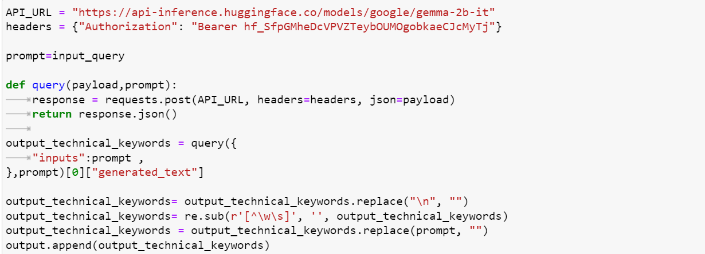
Approach
We have taken the job role as an input query, from the gemma model, we have generated a prompt providing us with keywords related to the query. We sourced the API of the gemma from hugging face. This code snippet fetches related keywords from gemma for the input_query.

Slide 4
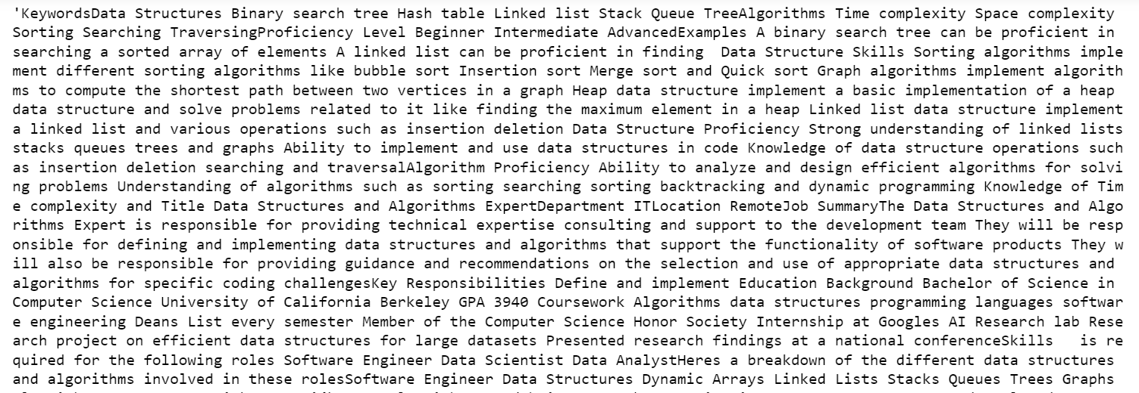
Approach
We read the pdf of the resume using the PyPDF2 library. We have extracted
Text generated using gemma for software development
We read the pdf of the resume using the PyPDF2 library. We have extracted text from the resume pdf and then we have split the text between special character.

Slide 5
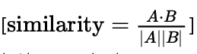
Approach
For each line, we find its cosine similarity with the prompt generated using gemma.
Cosine similarity is a mathematical metric used to measure the similarity between two vectors in a multi-dimensional space, particularly in high-dimensional spaces, by calculating the cosine of the angle between them.
Example: Let’s say we have two sentences:
Sentence 1: “The cat sits outside.”
Sentence 2: “The dog plays in the garden.”
We convert these sentences into vectors and calculate their cosine similarity. If the similarity score is close to , it indicates that the sentences are semantically similar.

Slide 6
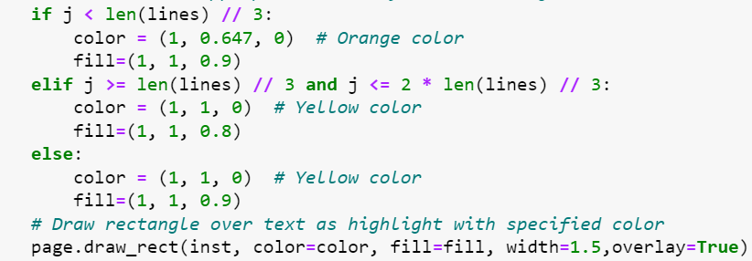
Approach
The cosine similarities for each line are then sorted in a decreasing fashion and then we select 20% lines with the highest cosine similarities to highlight in the resume.
Then, We highlighted the pdf using the PyMuPDF library
First 33 percent are highlighted as Orange
Next 33 percent are highlighted as
Yellow
Last 33 percent are highlighted as light Yellow

Slide 7
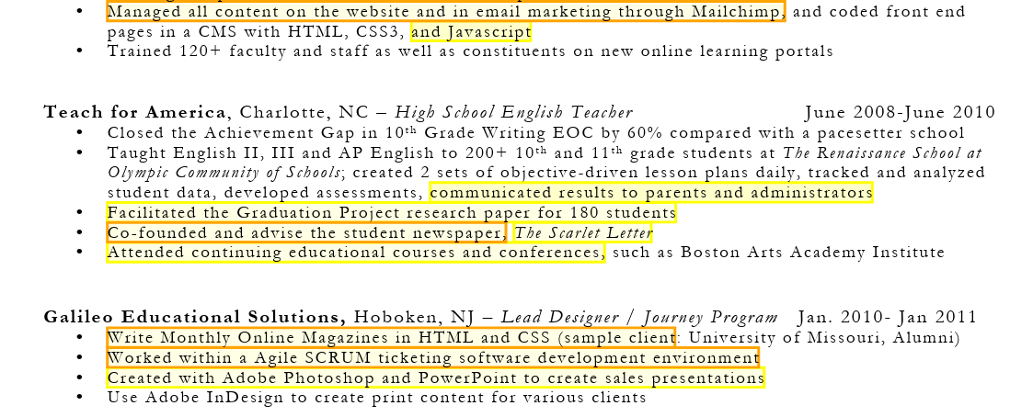
Example
Query: Notable achievement in Software development

Slide 8
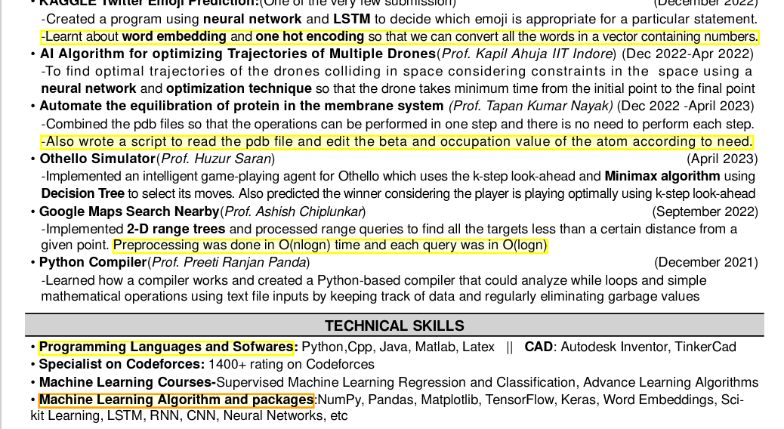
Example on our CV
Query:Machine learning and artificial intelligence

Slide 9
Scope of Improvement
Currently we are using pretrained Gemma model for generating text using prompt. But we can fine-tune our gemma model accordingly to get the desired output. For example- we need only related keywords related to query and do not need unnecessary words like “a”, “the”, “with”, ”your”.
For converting word to vector we are using Tfidfvectorizer(). But we can use transformer model to do this task as I think that will work better on this because TF-IDF Vectorizer may need domain-specific tuning, while Transformer Models leverage pre-training for strong performance across diverse domains without extensive fine-tuning.

Slide 10
Thank you

